Slide 1

School of Computing Science and Engineering
Course Code : CSAI2030 Course Name: Predictive Analytics
Introduction to ML Classification Techniques
Name of the Faculty: VIKASH KUMAR MISHRA Program Name: B.Tech

Slide 2
Traditional Programming
Process
Input
Output
y = x1 + x2
Or
y = f (x1,x2)
x1,x2
y

Slide 3
Machine Learning
x1 (Input) | y (Output)
2 | 4
3 | 6
4 | 8
5 | 10
6 | 12
7 | 14
8 | 16
y = 2 multiplied by x1

Slide 4
Machine Learning
Machine learning as – “Field of study that gives computers the capability to learn without being explicitly programmed”.
In a very layman manner, Machine Learning(ML) can be explained as automating and improving the learning process of computers based on their experiences without being actually programmed i.e. without any human assistance.

Slide 5
Machine Learning
Machine Learning Algorithm
Input
Process
Output
Machine Learning Algorithm
x1,x2
y=f(x1,x2)
y

Slide 6
What is requirement of Machine Learning Problem:
Data Set
Input (x1,x2,…)
Output
(y)

Slide 7
From where to get Data?
UCI Repository
https://archive.ics.uci.edu
Kaggle web site:
https://www.kaggle.com/datasets
United Nations
http://data.un.org/
India
https://data.gov.in/

Slide 8
What kind of problem Machine Learning can solve:
Machine Learning Algorithm
x1,x2
y=f(x1,x2)
y
Machine Learning Algorithm
Training Input (X)
Machine Learning Model
(X y)
Training Output(y)

Slide 9
What kind of problem Machine Learning can solve:
Machine Learning Algorithm
Training Input (X)
Machine Learning Model
(X y)
Training Output(y)
Machine Learning Model
Output
(y)
New Input (X)

Slide 10
Supervised Machine Learning
Supervised learning is the types of machine learning in which machines are trained using well "labelled" training data
On basis of that data, machines predict the output.
The labelled data means some input data is already tagged with the correct output.
The training data provided to the machines work as the supervisor that teaches the machines to predict the output correctly.
It applies the same concept as a student learns in the supervision of the teacher.

Slide 11
Supervised Machine Learning
The aim of a supervised learning algorithm is to find a mapping function to map the input variable(x) with the output variable(y).
In the real-world, supervised learning can be used for Risk Assessment, Image classification, Fraud Detection, spam filtering, etc.

Slide 12
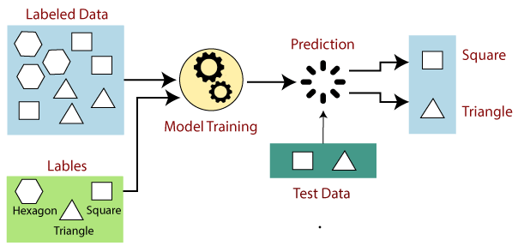
How Supervised Learning Works?
In supervised learning, models are trained using labelled dataset, where the model learns about each type of data.
Once the training process is completed, the model is tested on the basis of test data (a subset of the training set), and then it predicts the output.

Slide 13
Steps Involved in Supervised Learning
First Determine the type of training dataset
Collect/Gather the labelled training data.
Split the training dataset into training dataset, test dataset, and validation dataset.
Determine the input features of the training dataset, which should have enough knowledge so that the model can accurately predict the output.
Determine the suitable algorithm for the model, such as support vector machine, decision tree, etc.
Execute the algorithm on the training dataset. Sometimes we need validation sets as the control parameters, which are the subset of training datasets.
Evaluate the accuracy of the model by providing the test set. If the model predicts the correct output, which means our model is accurate.

Slide 14
Example
Regression
Linear Regression
Non-Linear Regression
Polynomial Regression
Classification
Random Forest
Decision Trees
Support vector Machines

Slide 15
Unsupervised Learning
Unsupervised learning is a machine learning technique in which models are not supervised using training dataset.
Instead, models itself find the hidden patterns and insights from the given data.
It can be compared to learning which takes place in the human brain while learning new things.
we have the input data but no corresponding output data.

Slide 16
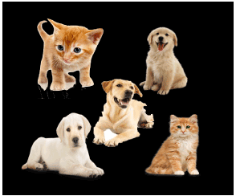
Example
Suppose the unsupervised learning algorithm is given an input dataset containing images of different types of cats and dogs. .
The task of the unsupervised learning algorithm is to identify the image features on their own.
Unsupervised learning algorithm will perform this task by clustering the image dataset into the groups according to similarities between images.

Slide 17
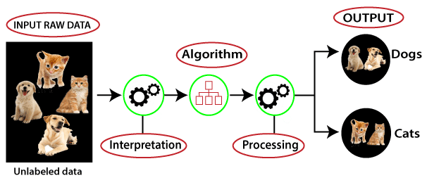
Working of Unsupervised Learning
Here, we have taken an unlabeled input data, which means it is not categorized and corresponding outputs are also not given.
Now, this unlabeled input data is fed to the machine learning model in order to train it.
Firstly, it will interpret the raw data to find the hidden patterns from the data and then will apply suitable algorithms

Slide 18
Unsupervised Learning algorithms
K-means clustering
KNN (k-nearest neighbors)
Hierarchal clustering
Principle Component Analysis
Independent Component Analysis
Apriori algorithm

Slide 19
Regression Analysis
Regression analysis is a statistical method to model the relationship between a dependent (target) and independent (predictor) variables with one or more independent variables.
More specifically, Regression analysis helps us to understand how the value of the dependent variable is changing corresponding to an independent variable when other independent variables are held fixed

Slide 20
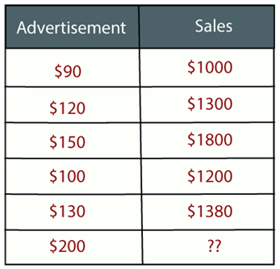
Example
Suppose there is a marketing company A, who does various advertisement every year and get sales on that.
The below list shows the advertisement made by the company in the last 5 years and the corresponding sales
Now, the company wants to do the advertisement of $200 in the year 2019 and wants to know the prediction about the sales for this year.
So to solve such type of prediction problems in machine learning, we need regression analysis.

Slide 21
Terminologies Related to the Regression Analysis
Dependent Variable:
The main factor in Regression analysis which we want to predict or understand is called the dependent variable.
It is also called target variable.
Independent Variable:
The factors which affect the dependent variables or which are used to predict the values of the dependent variables are called independent variable, also called as a predictor.
Outliers:
Outlier is an observation which contains either very low value or very high value in comparison to other observed values.
An outlier may hamper the result, so it should be avoided.

Slide 22
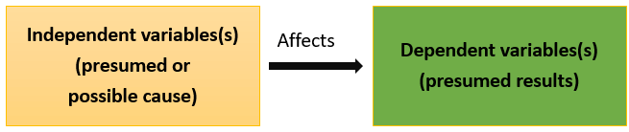
Example
How higher education can lead to higher Income:
Higher education: Independent variable
Higher Income: Dependent variable

Slide 23
Linear Regression
Linear regression is a statistical regression method which is used for predictive analysis.
It is one of the very simple and easy algorithms which works on regression and shows the relationship between the continuous variables.
It is used for solving the regression problem in machine learning.
Linear regression shows the linear relationship between the independent variable (X-axis) and the dependent variable (Y-axis), hence called linear regression.

Slide 24
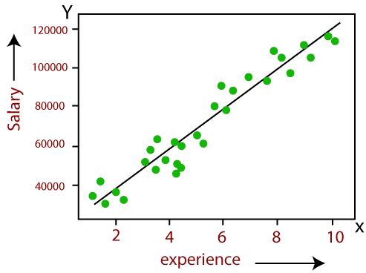
Linear Regression
If there is only one input variable (x), then such linear regression is called simple linear regression.
if there is more than one input variable, then such linear regression is called multiple linear regression.

Slide 25
Mathematical equation for Linear regression
Y = a + bX + ϵ
Where:
Y – Dependent variable
X – Independent (explanatory) variable
a – Intercept
b – Slope
ϵ – Residual (error)

Slide 26
Multiple Linear Regression
Multiple linear regression analysis is essentially similar to the simple linear model, with the exception that multiple independent variables are used in the model.
The mathematical representation of multiple linear regression is:
Y = a + bX1 + cX2 + dX3 + ϵ
Where:
Y – Dependent variable
X1, X2, X3 – Independent (explanatory) variables
a – Intercept
b, c, d – Slopes
ϵ – Residual (error)

Slide 27
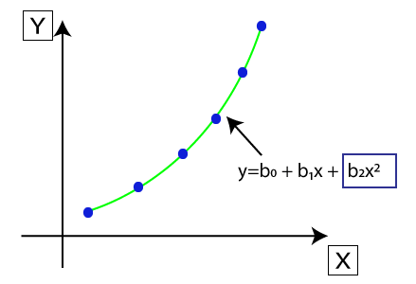
Polynomial Regression
Polynomial Regression is a type of regression which models the non-linear dataset
It is similar to multiple linear regression, but it fits a non-linear curve between the value of x and corresponding conditional values of y.

Slide 28
Regression
Calculates approximation of a continuous variable
For Example:
Estimated household income for loan processing or credit card limit etc.
Estimated Crop production in an area
Estimated traffic at a place
Estimated future requirement for saving/investment

Slide 29
What kind of problem Machine Learning can solve:
S. No. | Area | bedrooms | bathrooms | stories | parking | Price >650000
1 | 585 | 3 | 1 | 2 | no | No
2 | 400 | 2 | 1 | 1 | no | No
3 | 306 | 3 | 1 | 1 | no | No
4 | 665 | 3 | 1 | 2 | yes | No
5 | 636 | 2 | 1 | 1 | no | No
6 | 416 | 3 | 1 | 1 | yes | Yes
7 | 388 | 3 | 2 | 2 | no | Yes
8 | 416 | 3 | 1 | 3 | no | Yes
9 | 480 | 3 | 1 | 1 | yes | Yes
10 | 550 | 3 | 2 | 4 | yes | Yes
11 | 720 | 3 | 2 | 1 | no | Yes
This is called Classification Problem

Slide 30
What kind of problem Machine Learning can solve:
S. No. | Area | bedrooms | bathrooms | stories | parking | House Cost
1 | 585 | 3 | 1 | 2 | no | Low
2 | 400 | 2 | 1 | 1 | no | Low
3 | 306 | 3 | 1 | 1 | no | Low
4 | 665 | 3 | 1 | 2 | yes | Medium
5 | 636 | 2 | 1 | 1 | no | Medium
6 | 416 | 3 | 1 | 1 | yes | Medium
7 | 388 | 3 | 2 | 2 | no | Medium
8 | 416 | 3 | 1 | 3 | no | High
9 | 480 | 3 | 1 | 1 | yes | High
10 | 550 | 3 | 2 | 4 | yes | High
11 | 720 | 3 | 2 | 1 | no | High
This is called Classification Problem

Slide 31
Classification
Examining the feature of a newly presented object and assigning it to one of the predefined classes.
For Example:
Classifying loan applications as Low, Medium and High Risk
Assigning product into Categories and sub-categories
Classifying people as BPL etc.

Slide 32
Feature and Outcome
S. No. | Area | bedrooms | bathrooms | Floor | parking | House Cost
1 | 585 | 3 | 1 | 2 | no | Low
2 | 400 | 2 | 1 | 1 | no | Low
3 | 665 | 3 | 1 | 2 | yes | Medium
4 | 636 | 2 | 1 | 1 | no | Medium
5 | 416 | 3 | 1 | 3 | no | High
6 | 480 | 3 | 1 | 1 | yes | High
Features (X) : Area, bedrooms, bathrooms, Floor, parking
Predictors, Independent Variable
Outcome (y): House Cost
Dependent Variable, Result

Slide 33
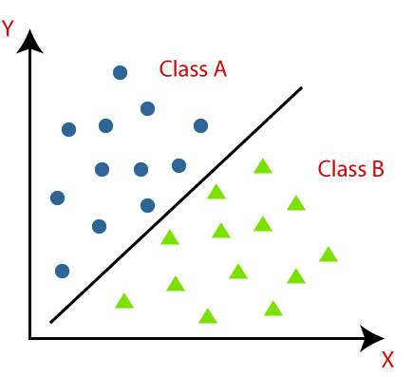
What is the Classification Algorithm?
The Classification algorithm is a Supervised Learning technique that is used to identify the category of new observations on the basis of training data.
In Classification,
a program learns from the given dataset or observations
then classifies new observation into a number of classes or groups.
Such as, Yes or No, 0 or 1, Spam or Not Spam, cat or dog, etc.

Slide 34
Types of Classifications
Binary Classifier: If the classification problem has only two possible outcomes, then it is called as Binary Classifier. Examples:
YES or NO, MALE or FEMALE, SPAM or NOT SPAM, CAT or DOG, etc.
Multi-class Classifier: If a classification problem has more than two outcomes, then it is called as Multi-class Classifier. Example:
Classifications of types of crops, Classification of types of music.

Slide 35
Types of ML Classification Algorithms
Linear Models
Logistic Regression
Support Vector Machines
Non-linear Models
K-Nearest Neighbours
Kernel SVM
Naïve Bayes
Decision Tree Classification
Random Forest Classification

Slide 36
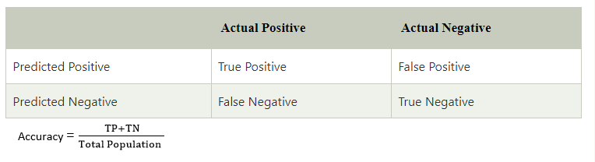
Evaluating a Classification model
Confusion Matrix:
The confusion matrix provides us a matrix/table as output and describes the performance of the model.
It is also known as the error matrix.
The matrix consists of predictions result in a summarized form, which has a total number of correct predictions and incorrect predictions.

Slide 37
Clustering
Clustering or cluster analysis is a machine learning technique, which groups the unlabelled dataset.
Define as
A way of grouping the data points into different clusters, consisting of similar data points. The objects with the possible similarities remain in a group that has less or no similarities with another group.“
It is an unsupervised learning method,
hence no supervision is provided to the algorithm
it deals with the unlabeled dataset.

Slide 38
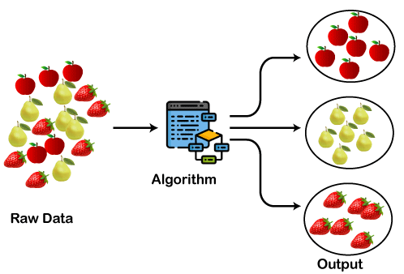
Usage
The clustering technique can be widely used in various tasks. Some most common uses of this technique are:
Market Segmentation
Statistical data analysis
Social network analysis
Image segmentation
Anomaly detection, etc.

Slide 39
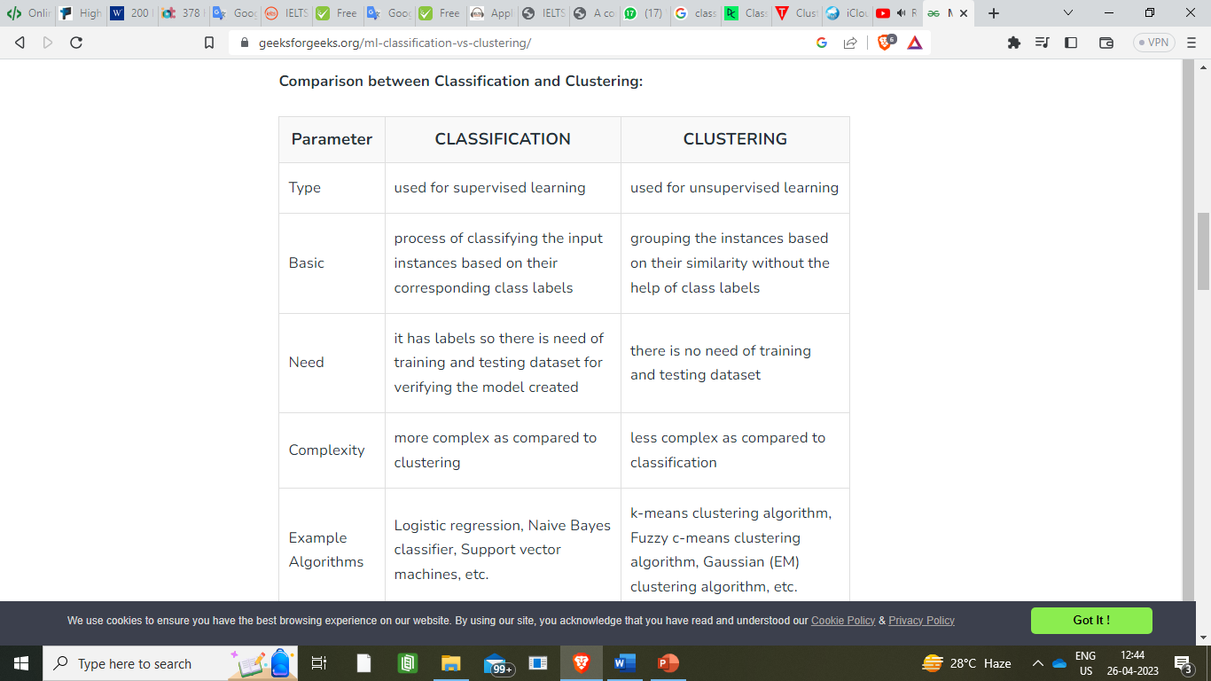
Comparison: Classification and Clustering

Slide 40
Types of Clustering Methods
Partitioning Clustering
Density-Based Clustering
Distribution Model-Based Clustering
Hierarchical Clustering
Fuzzy Clustering

Slide 41
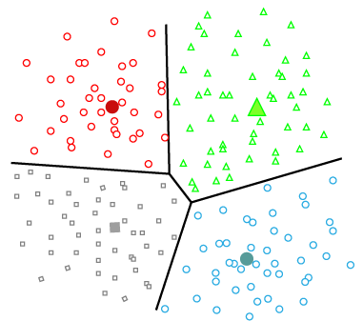
Partitioning Clustering
It is also known as the centroid-based method.
The most common example is the K-Means Clustering algorithm.
Here, the dataset is divided into a set of k groups,
where K is used to define the number of pre-defined groups.
The cluster center is created
in such a way that the distance between the data points of one cluster is minimum as compared to another cluster centroid.

Slide 42
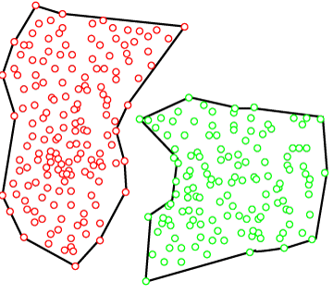
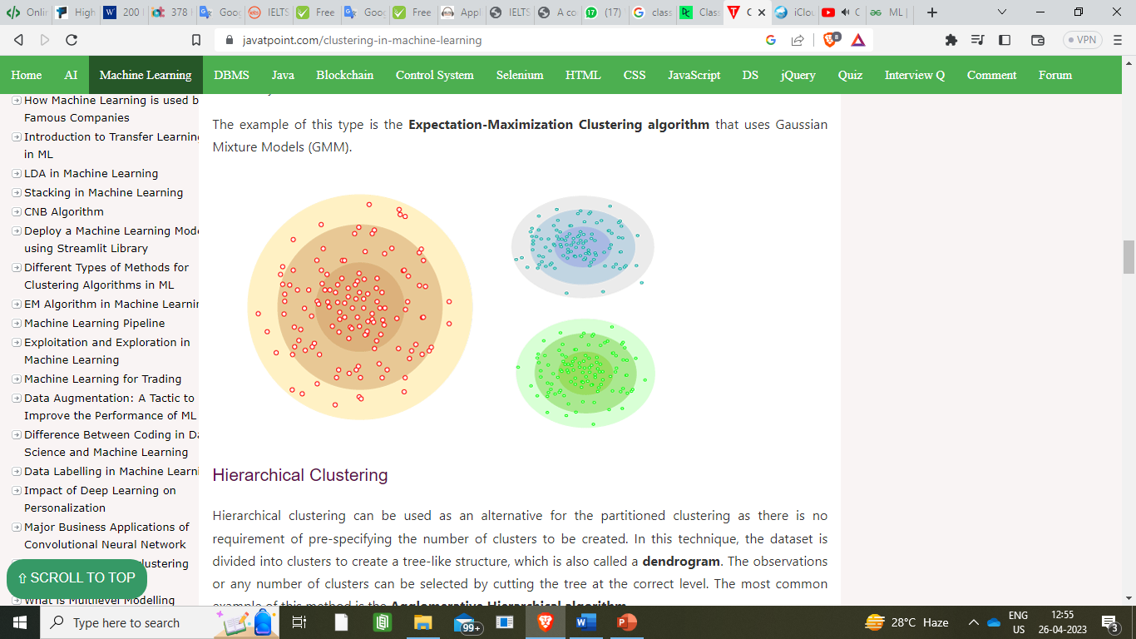
Density-Based Clustering
The density-based clustering method connects the highly-dense areas into clusters, and
Arbitrarily shaped distributions are formed as long as the dense region can be connected.
Distribution Model-Based Clustering
The data is divided based on the probability of how a dataset belongs to a particular distribution.
The grouping is done by assuming some distributions commonly Gaussian Distribution.

Slide 43
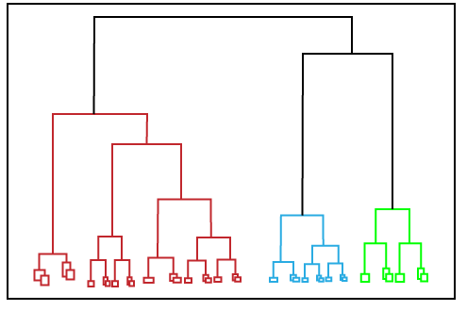
Hierarchical Clustering
In this technique, the dataset is divided into clusters to create a tree-like structure.
The most common example of this method is the Agglomerative Hierarchical algorithm.

Slide 44
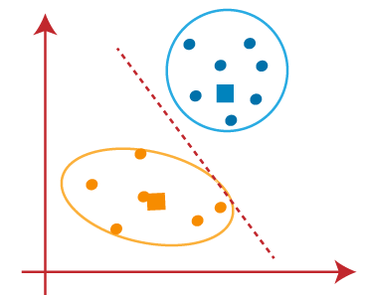
K-Means Clustering Algorithm
K-Means Clustering is an Unsupervised Learning algorithm, which groups the unlabeled dataset into different clusters.
Here K defines the number of pre-defined clusters that need to be created in the process
if K=2, there will be two clusters, and
K=3, there will be three clusters, and so on.

Slide 45
How does the K-Means Algorithm Work?
Step-1: Select the number K to decide the number of clusters.
Step-2: Select random K points or centroids. (It can be other from the input dataset).
Step-3: Assign each data point to their closest centroid, which will form the predefined K clusters.
Step-4: Calculate the variance and place a new centroid of each cluster.
Step-5: Repeat the third steps, which means reassign each datapoint to the new closest centroid of each cluster.
Step-6: If any reassignment occurs, then go to step-4 else go to FINISH.
Step-7: The model is ready.

